Slide 1

EBOLA OUTBREAK ANALYSIS & FORECASTS

Slide 2

https://data.hdx.rwlabs.org/dataset/rowca-ebola-cases
DATA SOURCE:
THE HUMANITARIAN DATA EXCHANGE

Slide 3
'data.frame': 58635 obs. of 5 variables: $ Country : Factor w/ 6 levels "Guinea","Liberia",..: 1 1 1 1 1 1 1 1 ... $ Localite: Factor w/ 126 levels "( Guekedou, Macenta and Kissidougou",..: 50... $ Category: Factor w/ 6 levels "Cases","Confirmed cases",..: 1 3 1 3 1 3 1 ... $ Value : Factor w/ 2802 levels "","-"," ","0",..: 2651 2156 2651 2218... $ Date : Factor w/ 291 levels "1-Apr-14","1-Aug-14",..: 158 158 167 167...
EBOLA DATA$FRAME
58,635 rows of data input!

Slide 4
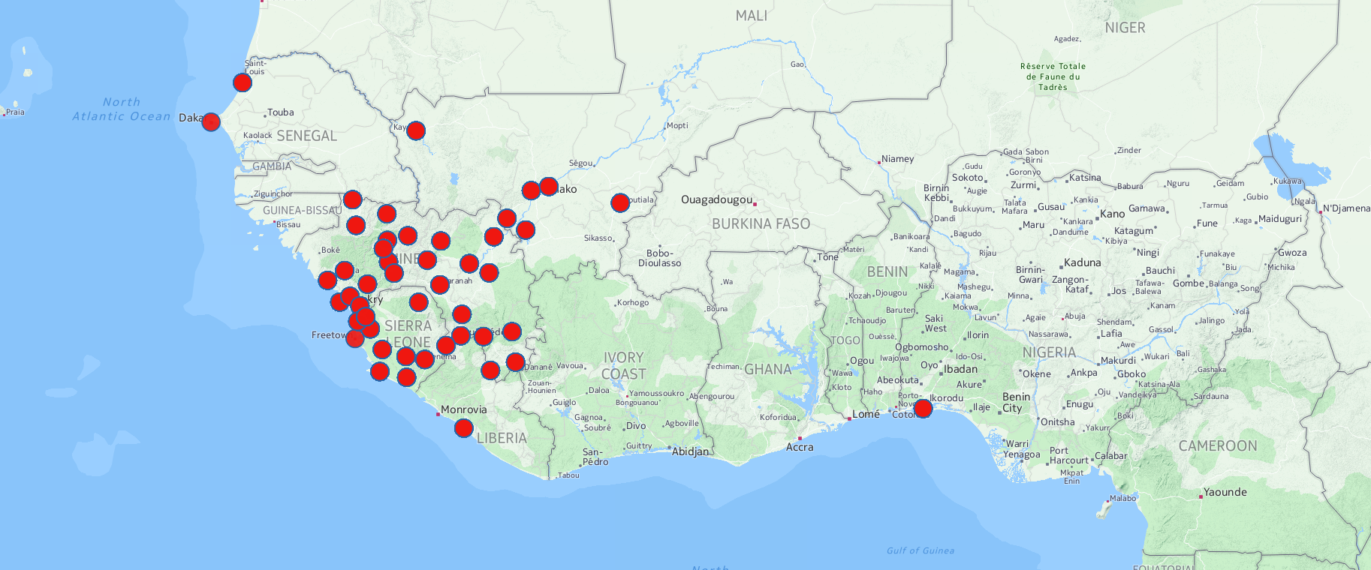
WEST AFRICA EBOLA MAP

Slide 5
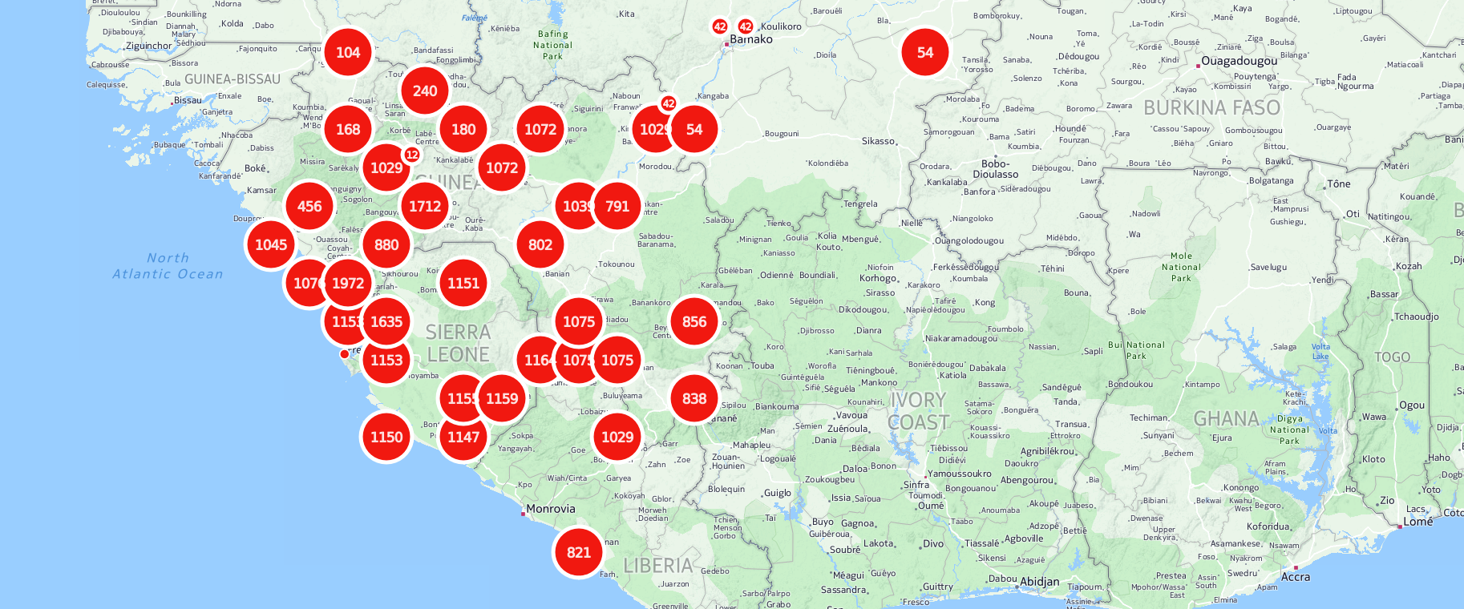
TOTAL EBOLA CASES – CONCENTRATION AREAS

Slide 7
TRIMMING THE DATASET
Extracting data on deaths only
> died=Ebola$Category=="Deaths"
> str(died)
logi [1:58635] FALSE TRUE FALSE TRUE FALSE TRUE ...
> EbolaDied=Ebola[died,]
> str(EbolaDied)
'data.frame': 10157 obs. of 7 variables:
$ Country : chr "Guinea" "Guinea" "Guinea" "Guinea" ...
$ Localite: chr "Guekedou, Macenta, Nzerekore and Kissidougou"...
$ Category: chr "Deaths" "Deaths" "Deaths" "Deaths" ...
$ Value : chr "59" "60" "62" "66" ...
$ Date : chr "03/24/14" "03/25/14" "03/26/14" "03/27/14" ...
$ realDate: Date, format: "2014-03-24" "2014-03-25" ...
$ Numbers : num 59 60 62 66 70 80 83 5 3 59 ...

Slide 8
TRIMMING THE DATASET
Aggregating deaths on basis of day recorded – the NA problem
> A=aggregate(as.numeric(EbolaDied$Numbers),list(Day=EbolaDied$DateFactor),sum)
> str(A)
'data.frame': 290 obs. of 2 variables:
$ Day: Factor w/ 290 levels "01/01/15","01/02/15",..: 1 2 3 4 5 6 7 8 9 10 ...
$ x : num NA NA NA NA NA NA NA NA NA NA ...
> sum(EbolaDied$Numbers)
[1] NA

Slide 9
TRIMMING THE DATASET
Removing NA value problem
> EbolaDiedGood = EbolaDied[!is.na(EbolaDied$Numbers),]
> range(EbolaDiedGood$Numbers)
[1] 0 1539
> head(EbolaDiedGood)
Country Localite Category Value
2 Guinea Guekedou, Macenta, Nzerekore and Kissidougou Deaths 59
4 Guinea ( Guekedou, Macenta and Kissidougou Deaths 60
6 Guinea ( Guekedou, Macenta and Kissidougou) Deaths 62
8 Guinea ( Guekedou, Macenta and Kissidougou) Deaths 66
9 Guinea ( Guekedou, Macenta,Kissidougou,Lofa,Kankan and Conakry) Deaths 70
18 Guinea National Deaths 80

Slide 10
FOCUSING RESEARCH QUESTION
Can we predict the number of deaths to be caused by Ebola in Liberia for the next 365 days?

Slide 11
DEATHS CAUSED BY EBOLA – LIBERIA
> libDead=EbolaDiedGood$Country=="Liberia"
> libDeadTrue=EbolaDiedGood[libDead,]
> str(libDeadTrue)
'data.frame': 2071 obs. of 8 variables:
$ Country : chr "Liberia" "Liberia" "Liberia" "Liberia" ...
$ Localite : chr "National" "National" "Bong County" "Grand Cape Mount" ...
$ Category : chr "Deaths" "Deaths" "Deaths" "Deaths" ...
$ Value : chr "10" "12" "0" "0" ...
$ Date : chr "04/08/14" "04/09/14" "04/10/14" "04/10/14" ...
$ realDate : Date, format: "2014-04-08" "2014-04-09" ...
$ Numbers : num 10 12 0 0 9 1 1 12 1 0 ...
$ DateFactor: Factor w/ 290 levels "01/01/15","01/02/15",..: 94 95 96 96 96...

Slide 12
DEATHS CAUSED BY EBOLA – LIBERIA
> A=aggregate(libDeadTrue$Numbers,list(Day=libDeadTrue$realDate),sum)
> head(A)
Day x
1 2014-04-08 10
2 2014-04-09 12
3 2014-04-10 24
4 2014-04-13 26
5 2014-04-16 26
> summary(libDeadTrue$Numbers)
Min. 1st Qu. Median Mean 3rd Qu. Max.
0.0 9.0 27.0 108.2 126.0 1539.0
Highest Death Toll
1539 DEATHS recorded in a day!

Slide 13
EXPLORING TREND IN DEATHS OVER TIME
TOOL USED: Time Series in R
INTERVAL: April 8, 2014 to February 9, 2015

Slide 15
DATA FORECASTING – EXPONENTIAL SMOOTHING
Holt-Winters exponential smoothing with trend and without seasonal component.
Call:
HoltWinters(x = Dts, gamma = FALSE)
Smoothing parameters:
alpha: 0.4794476
beta : 0
gamma: FALSE
Coefficients:
[,1]
a 1599.433
b 2.000

Slide 16
EXPONENTIAL SMOOTHING – FITTED MODEL

Slide 18
PREDICTION RIGHT OR WRONG?

Slide 19
> F=libDeadTrue[libDeadTrue$realDate=="2015-02-09",]
> F
Country Localite Category Value Date realDate Numbers DateFactor
49134 Liberia Bomi County Deaths 174 02/09/15 2015-02-09 174 02/09/15
49135 Liberia Bong County Deaths 159 02/09/15 2015-02-09 159 02/09/15
49136 Liberia Gbarpolu County Deaths 13 02/09/15 2015-02-09 13 02/09/15
49137 Liberia Grand Bassa Deaths 80 02/09/15 2015-02-09 80 02/09/15
49138 Liberia Grand Cape Mount Deaths 201 02/09/15 2015-02-09 201 02/09/15
49139 Liberia Grand Gedeh Deaths 6 02/09/15 2015-02-09 6 02/09/15
49140 Liberia Grand Kru Deaths 27 02/09/15 2015-02-09 27 02/09/15
49141 Liberia Lofa County Deaths 405 02/09/15 2015-02-09 405 02/09/15
49142 Liberia Margibi County Deaths 582 02/09/15 2015-02-09 582 02/09/15
49143 Liberia Maryland County Deaths 23 02/09/15 2015-02-09 23 02/09/15
49145 Liberia Nimba County Deaths 60 02/09/15 2015-02-09 60 02/09/15
49146 Liberia River Gee County Deaths 16 02/09/15 2015-02-09 16 02/09/15
49147 Liberia RiverCess County Deaths 27 02/09/15 2015-02-09 27 02/09/15
> sum(F$Numbers)
[1] 1799
1799 DEATHS recorded in Liberia on 02/09/15! Hmm

Slide 20
EITHER DATA FROM HDX IS COMPLETELY MESSED UP OR I AM
Simply Unbelievable!

